Slide 1
Gore Iris Crimper Capstone
11/27/2022
Alex Nagle
Skylar Gilmore
Lumini Senaviratne
Alex Anderson
Eisa Alyaseen
Abdulrahman Aziz

Slide 2






Team
Alex
Nagle
Lumini
Mudiyanselage
Alex
Anderson
Eisa
Alyaseen
Skylar
Gilmore
Abdulrahman
Aziz
Project Lead
Test Engineer
Financial Manager
Logistics Manager
CAD Manager
Website Lead
Manufacturing
Manager
EE Team Lead
Lead Software
Developer
Financial
Manager
Website Lead
EE Team
Secretary

Slide 3

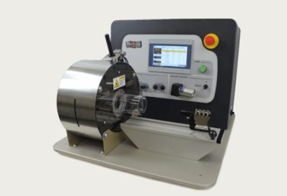
Project Description
"The goal of this project is to design and develop a low force stent crimping machine utilizing a crush iris with a radial force readout. "
The scope of the project within the mechanical team would be in selection of materials and the overall design of the machine.
Figure 1: Gore Logo [1]
Figure 2: Model CX with Large Twin-Cam [2]

Slide 4
Design Requirements
Table 2: Customer Requirements
Customer Requirements | Components/Methods in the device to meet the requirements
ANSI Safety Standards & OSHA Safety Standards | Electric shock warning, Lockout & Emergency stop [3]
Iris Design and iterative design process | 3 different iris designs – Curved iris Straight iris Plate rotation iris
Cost Control | 3D printed iris
Max Stent Length/Capacity to work under both Radial Force and Diameter | Will be obtained through the Engineering Analysis
Working Model | Manually operating prototype
To crimp | Iris design

Slide 5
Design Requirements
Table 3: Engineering Requirements

Slide 6
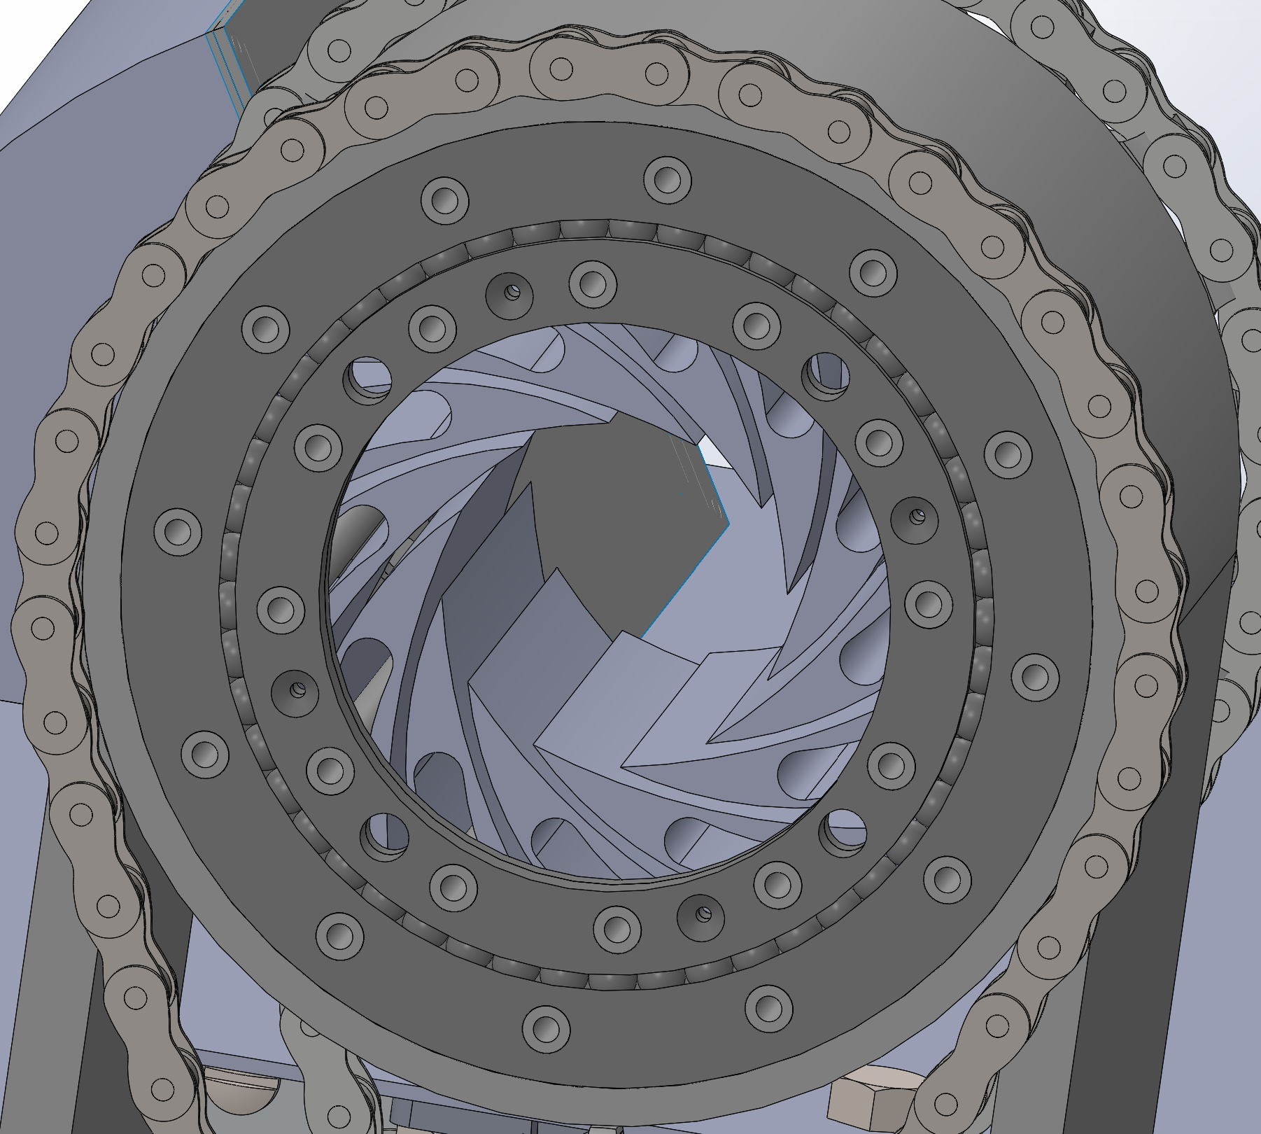
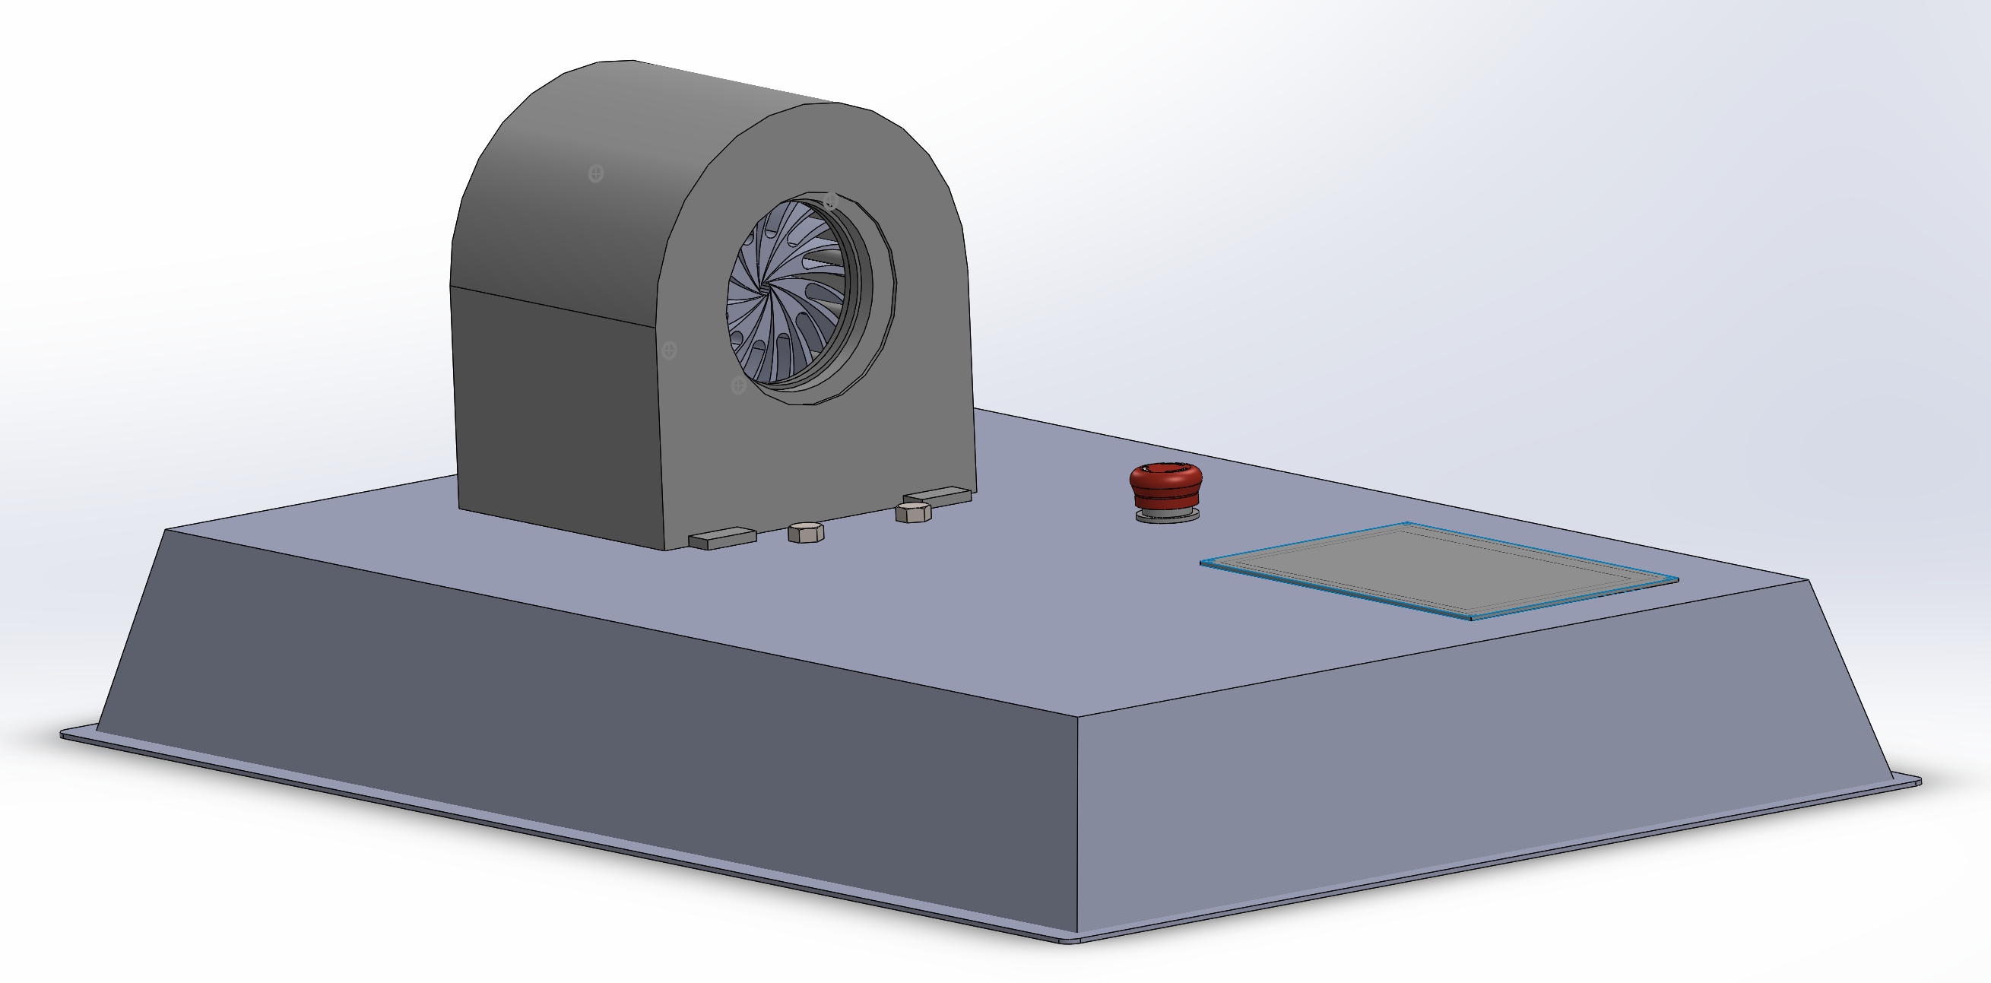
Complete CAD
Figure 1: Complete Assembly
Figure 2: CAD for Slew Bearing

Slide 7
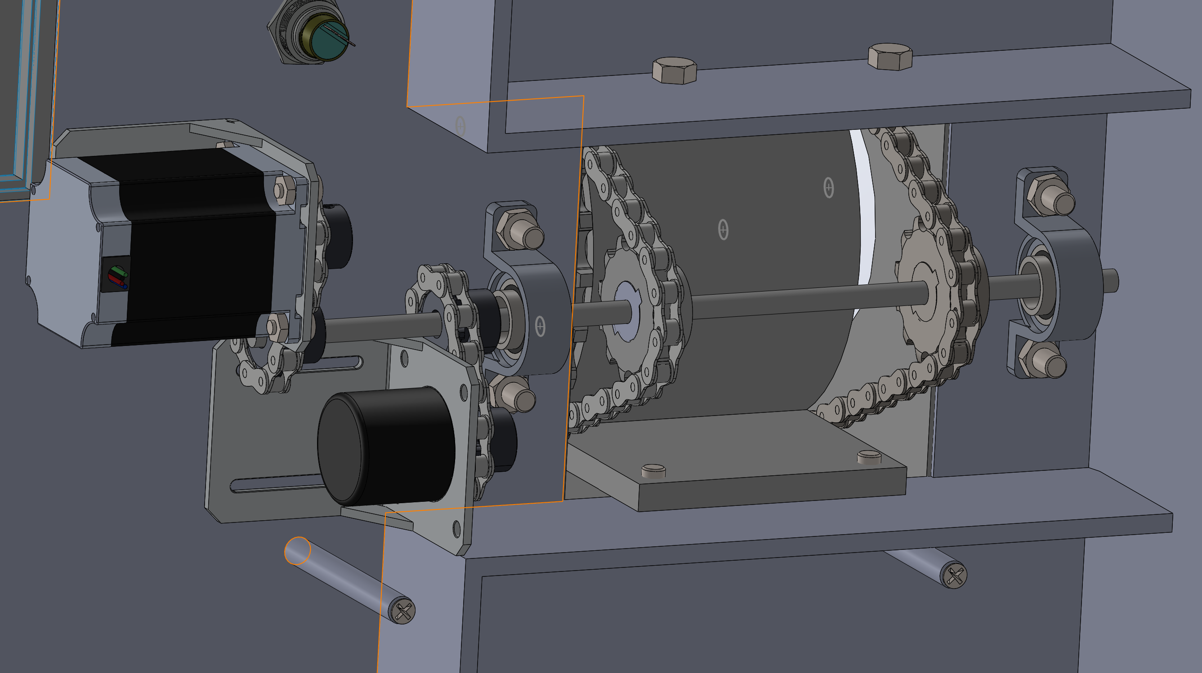
Complete CAD
Figure 3: Gear System

Slide 8
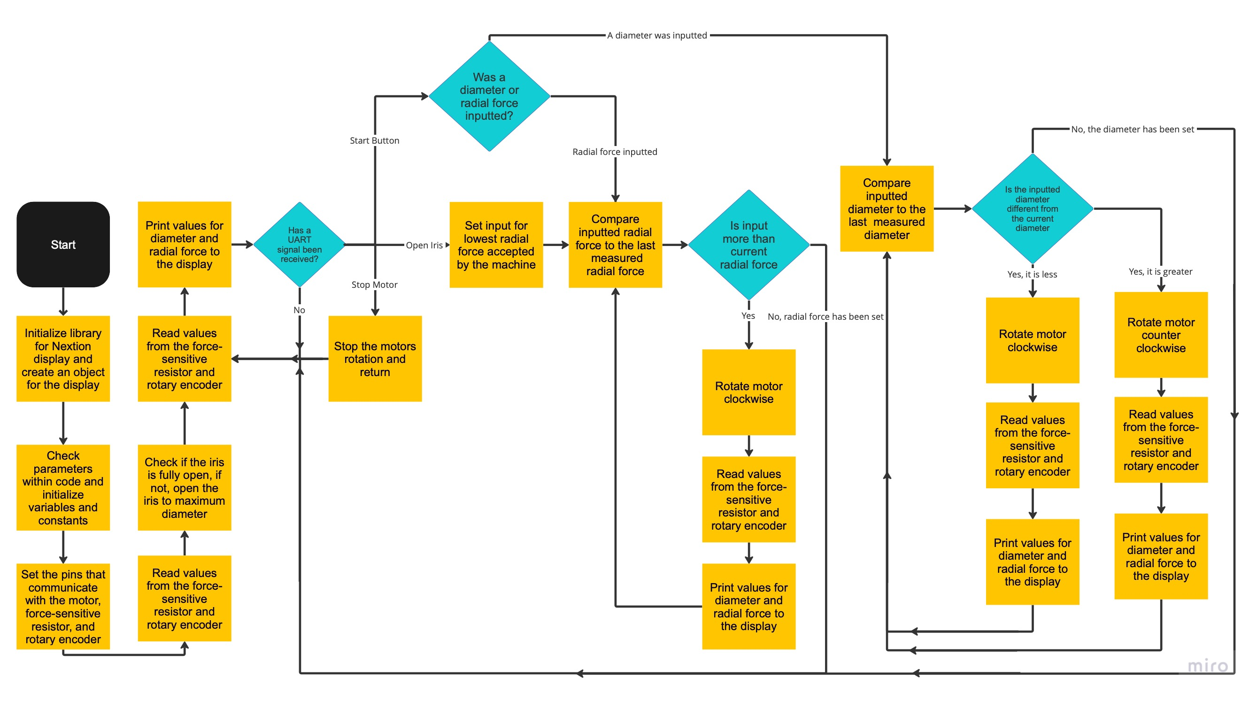
Flowchart
Figure 4: Flowchart Showing the Arduino’s processes

Slide 9
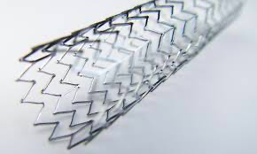
Click t ad text
Engineering Analysis
Figure 9. Nitinol stent [4]
Calculations for the
Required minimum
and maximum
diameters
Self-expandable stents using hoop strength calculations
H = PD /2t
H – hoop stress.
D- Diameter
t- Thickness
P – Internal Pressure
Materia/Type Dependence
Calculations for
Required radial forces
Radial reaction force (RF) at each increment to force response over time .
E- artery’s young’s modulus
Di – Internal Diameter
L – Stent Length
t - Thickness
Device Power
Requirement
GUI unit and the Crimping system
Wall power and standby battery

Slide 10
Bill of Materials

Slide 11
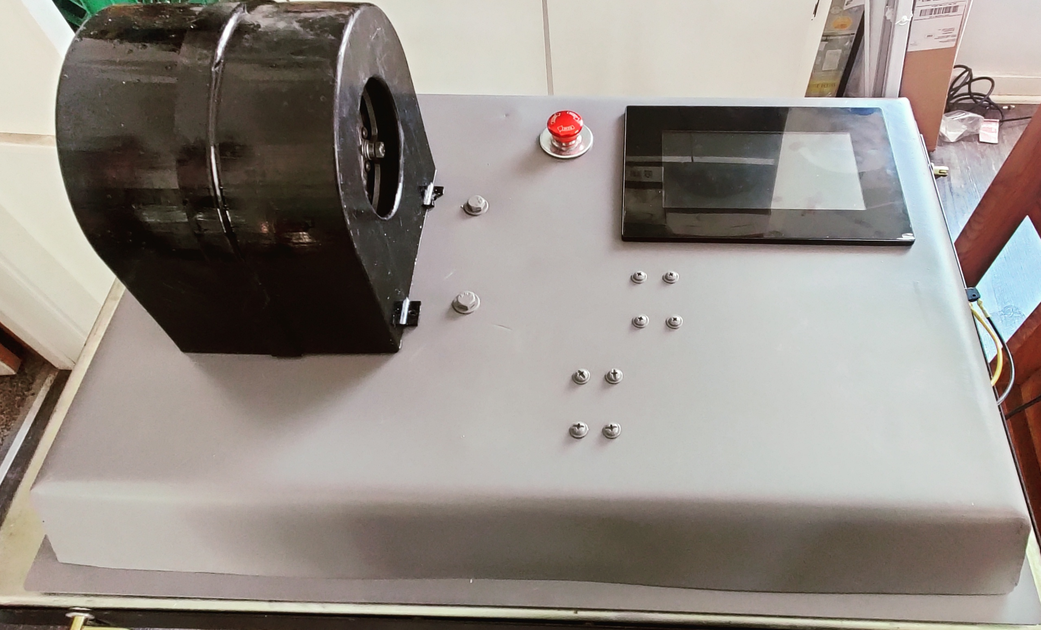
Manufacturing

Slide 12
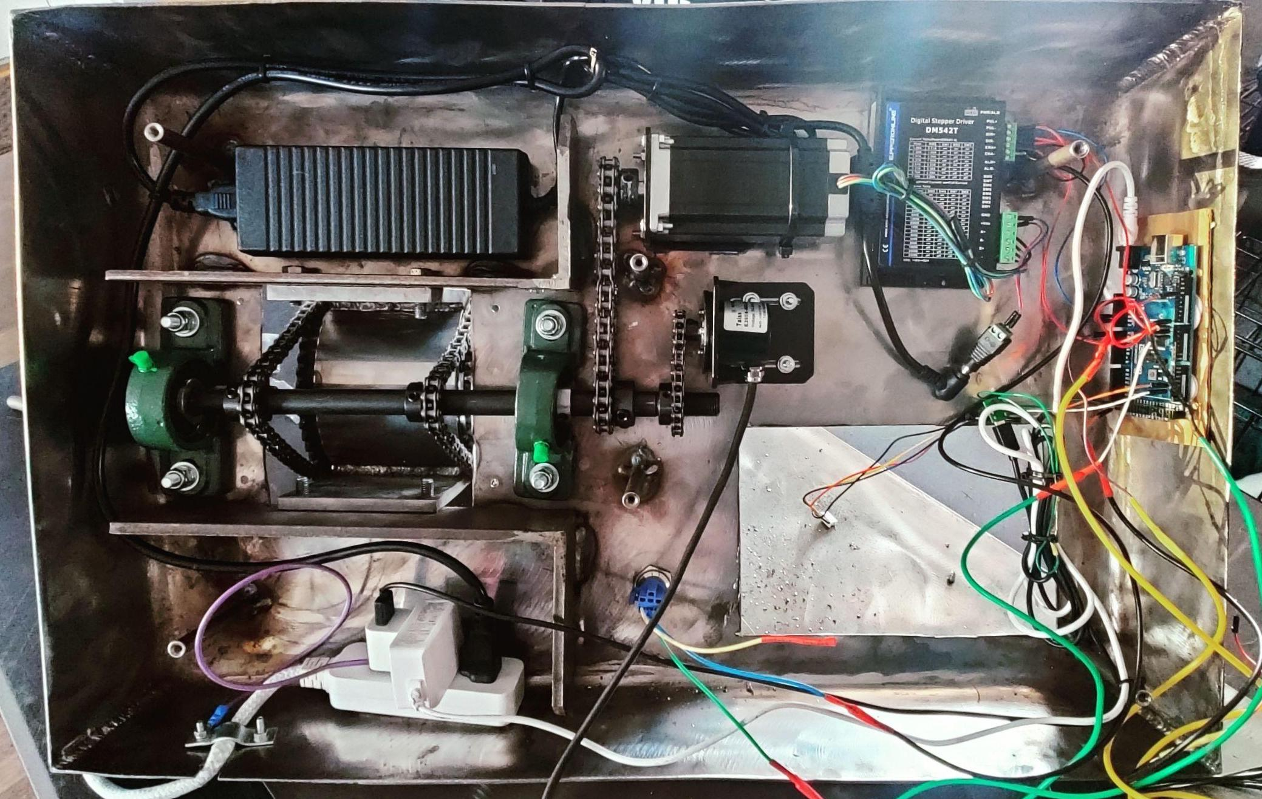
Electrical Components
Figure 5: Photograph of Underside of Machine Showing the Electronics

Slide 13
Purchasing Plan
Part | QTY | Supplier | Raw Material | Purchased
Outer Shell | 1 | American Metals | 5in Tube | Yes
Shell Legs | 2 | American Metals | 2' x2' 3/8" Plate | Yes
Primary Retaining Ring | 1 | American Metals | 2' x2' 3/8" Plate | Yes
Inner Ring | 1 | American Metals | 2' x2' 3/8" Plate | Yes
Stationary Pins | 12 | American Metals | 3/8" Steel Rod 10' | Yes
Motion Pins | 12 | American Metals | 1/4" Steel Rod 10' | Yes
Leaflets | 12 | NAU Idea Lab | Onex | Yes
Project Base | 1 | American Metals | 4'x4' 14 Gauge Plate | Yes
Base Bottom Cover | 1 | American Metals | 4'x4' 14 Gauge Plate | Yes
Base Pins | 6 | American Metals | 3/8" Steel Rod 10' | Yes
Base Support | 3 | American Metals | 2"x 1/4" Bar 10' | Yes
Pillow Block Bushings | 2 | Amazon | N/A | Yes
Sprocket | 2 | Amazon | N/A | Yes
Motor Hub Cog | 1 | Amazon | N/A | Yes
#35 Chain | 1 | Tractor Supply | N/A | Yes
5/8 Axle | 1 | BMI Parts | N/A | Yes
Cog | 3 | BMI Parts | N/A | Yes
Sprocket Collars | 1 | Amazon | N/A | Yes
Safety Plate | 2 | American Metals | 4'x4' 14 Gauge Plate | Yes
Rubber Feet | 6 | Amazon | N/A | Yes
Bolts | 6 | HomeCo | Brass | Yes
Total To Purchase | 77 | Total Purchased | 77 | 100%

Slide 14
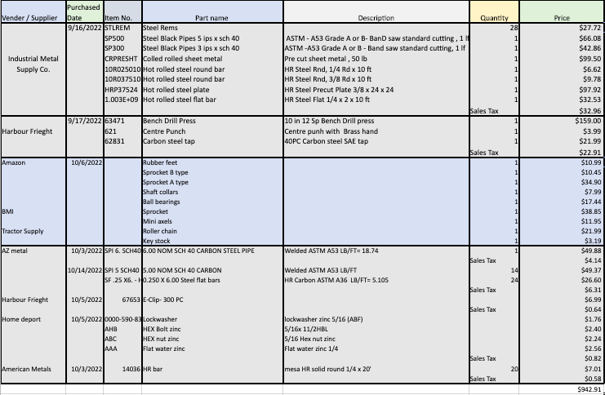
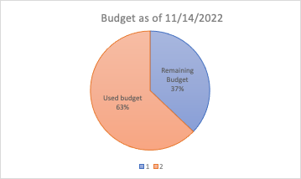
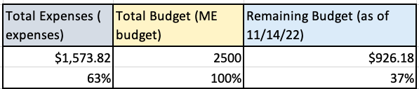
Budget as of 21st of October

Slide 15
Future Work
Test limits and increase strength of leaflets to alternate material
If desired to increase torque, increase power of motor
Code Arduino for more functionality and options with the touch screen

Slide 16
References
[1] "W. L. Gore & Associates," W. L. Gore & Associates, Inc., 13 June 2017. [Online]. Available: http://www.gore.com/. [Accessed 18 February 2022]. [2] “Model CX,” Blockwise Engineering, 12-Sep-2020. [Online]. Available: http://blockwise.com/stent-crimpers/cx/#CXLTC. [Accessed: 28-Jan-2022]. [3]
"Occupational Safety and Health Administration," United States Department of Labour , 22 March 2005. [Online]. Available: https://www.osha.gov/laws-regs/oshact/toc. [Accessed 28 March 2022]
[4] "Nitinol Technology Leader Uses Laser Cutting Machine for Precision Products," COHERENT , 2022. [Online].Available:https://www.coherent.com/news/success-stories/nitinol-innovative-technology. [Accessed 28 March 2022].

Slide 17
Thank you
Q & A

